Slide 1

SOEN 6441 ADVANCED PROGRAMMING PRACTICES
PROJECT: WARZONE
(BUILD - 03)
TEAM 15
Gaurang Dobariya-40184707
JAYNIL SAVANI-40156070
MANTHAN MORADIYA-40156072
VICKY PATEL-40185238
YASH VAGHANI-40155884
SUBMITTED TO: JOEY PAQUET

Slide 2
Introduction
Overview
Warzone is a strategy game where each player tries to conquer all countries on a map based upon specific turns.
Warzone is categorized into two different phases:
Map Editor: - In this phase, map related activities such as create a new map, edit existing map, show map, save map, and validate map can be done.
Game Play: - Gameplay consist of three sub phases.
Start-up Phase
Issue Order Phase
Execute Order Phase
Technologies Adapted
Spring Framework - Development framework used for Java.
-Xdoclint – To generate API document of java doc
Java FX - Handling and rendering the User Interface elements.
JUnit 4 - Unit testing framework used for testing unit test cases

Slide 3
Introduction
Architecture Design
Goal and architectural design of Warzone is described in detail. In this project, we are developing Warzone. The Warzone is developed using Extreme Programming approach by following its features such as collective ownership, pair programming, continuous integration, and testing. Here, we are specifically following incremental development model and releasing build with small number of features in each iteration. Furthermore, this game is developed using MVC (Model, View, Controller) architecture with State Pattern, Command Pattern and Observer Pattern.
Reasons to include MVC (Model View Controller) design pattern in Warzone is described below:
User interaction is high.
Provides separation of concerns.
Provides support for rapid and parallel development.
Provides multiple view of model.
Modification in model does not affect entire architecture and views

Slide 4
Objectives
Map Editor
User Driven creation or deletion of map elements (country, continent, and connectivity between countries)
Create a new map
Edit an existing map
Show map
Save map
Validate map
Game Play
Start up Phase
Create and Add player
Assign countries to player
Issue Order Phase
Assign Reinforcements
Issue Orders
Execute Order Phase
Execute Orders

Slide 5
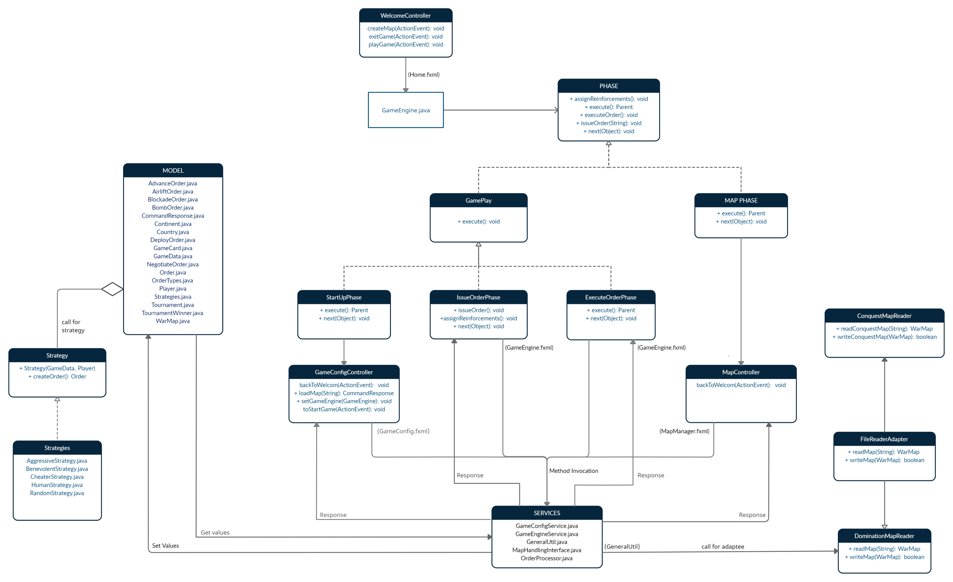
MVC Architecture Design

Slide 6
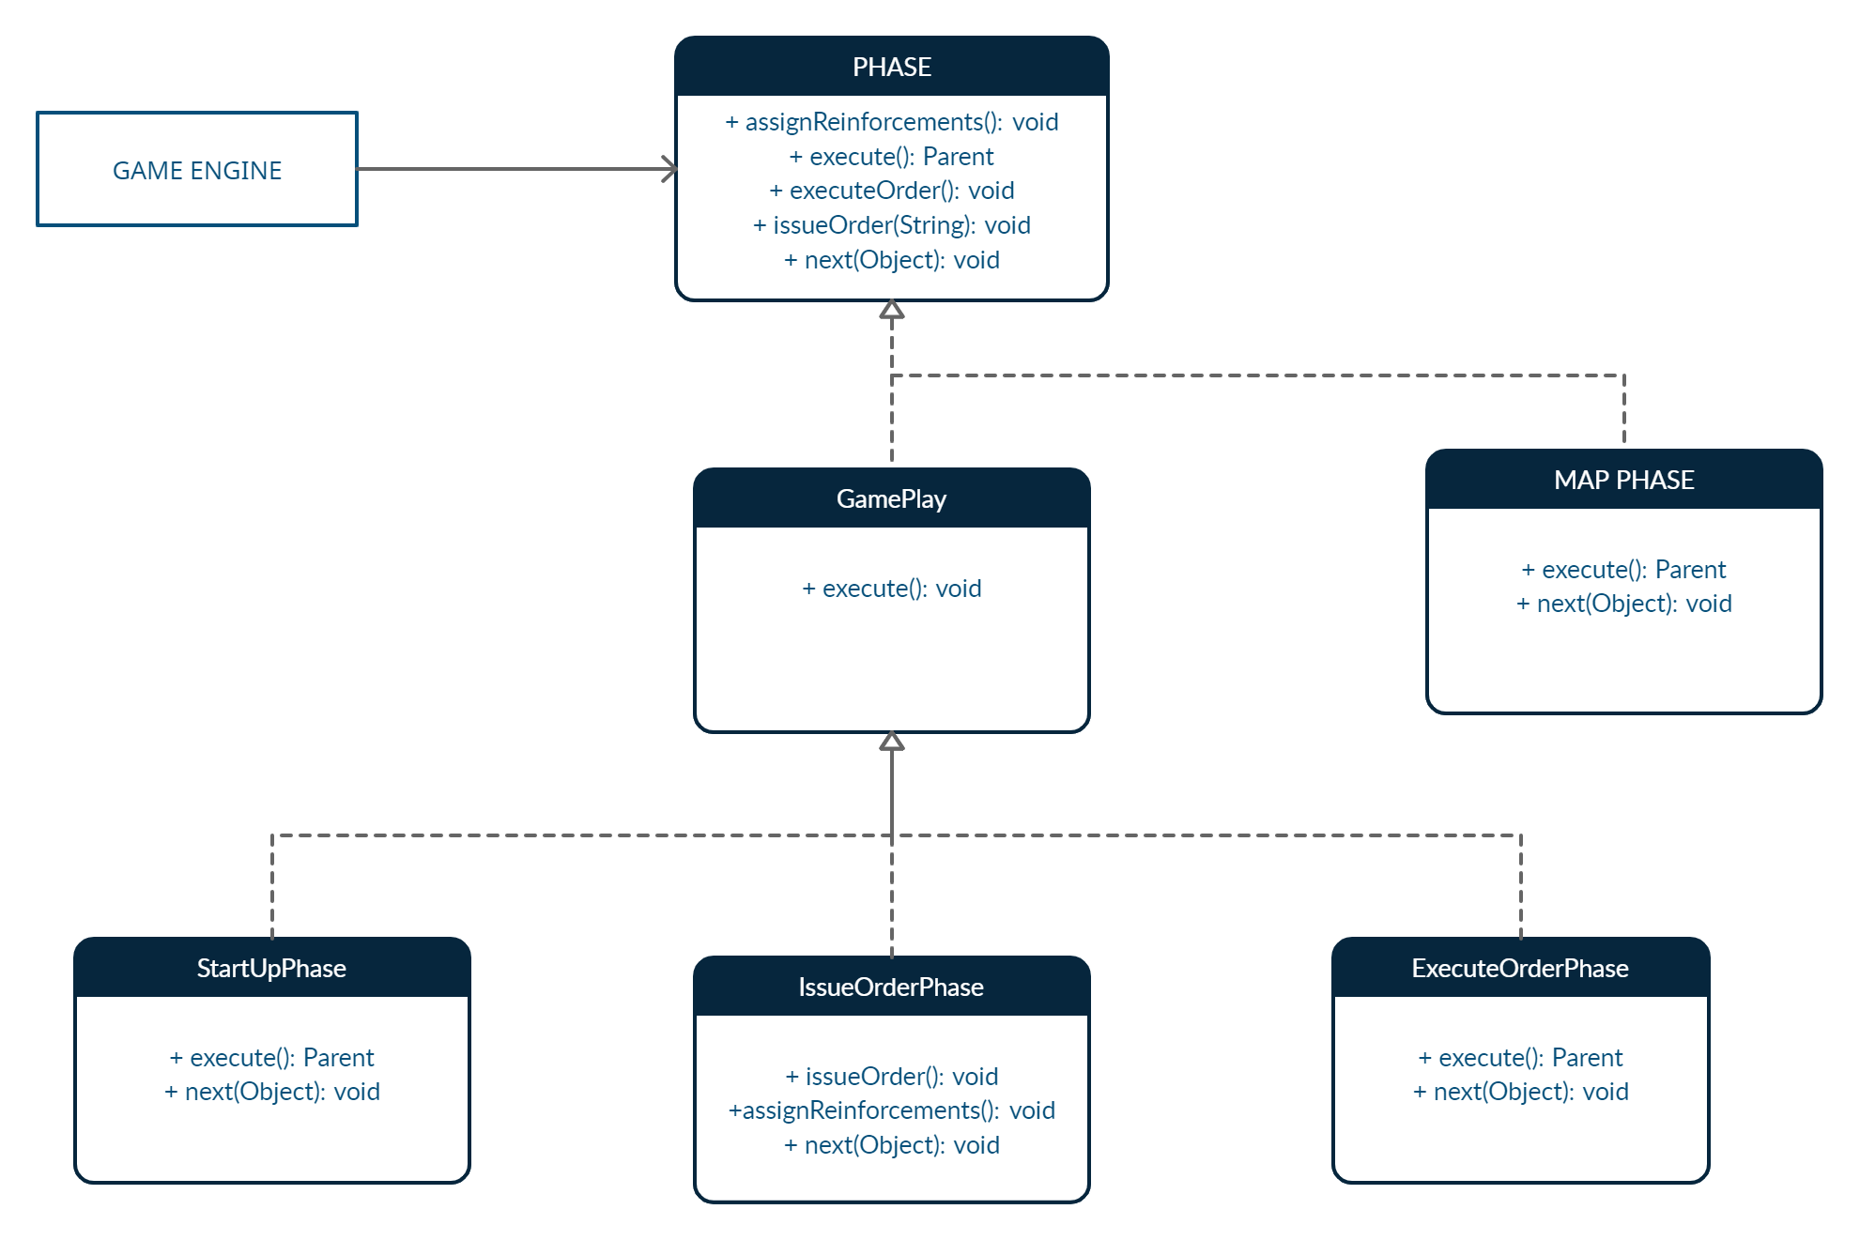
State Pattern Design

Slide 7
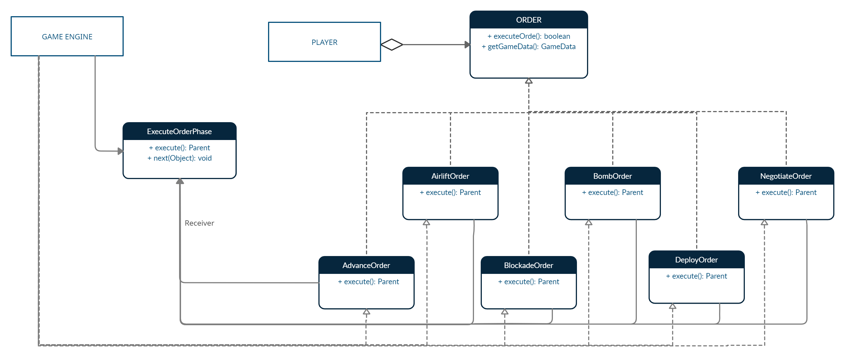
Command Pattern Design

Slide 8
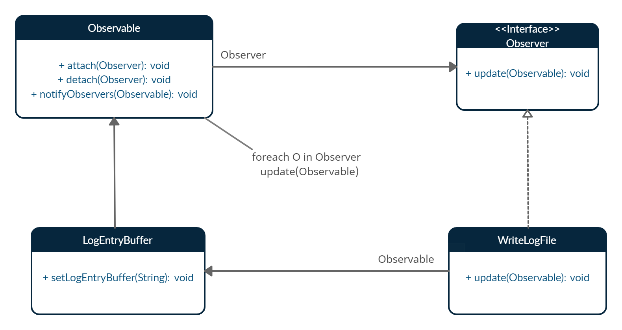
Observer Pattern Design

Slide 9
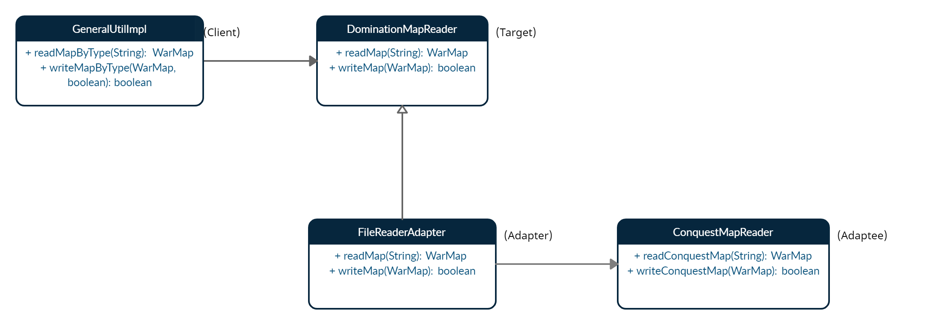
Adapter Pattern Design

Slide 10
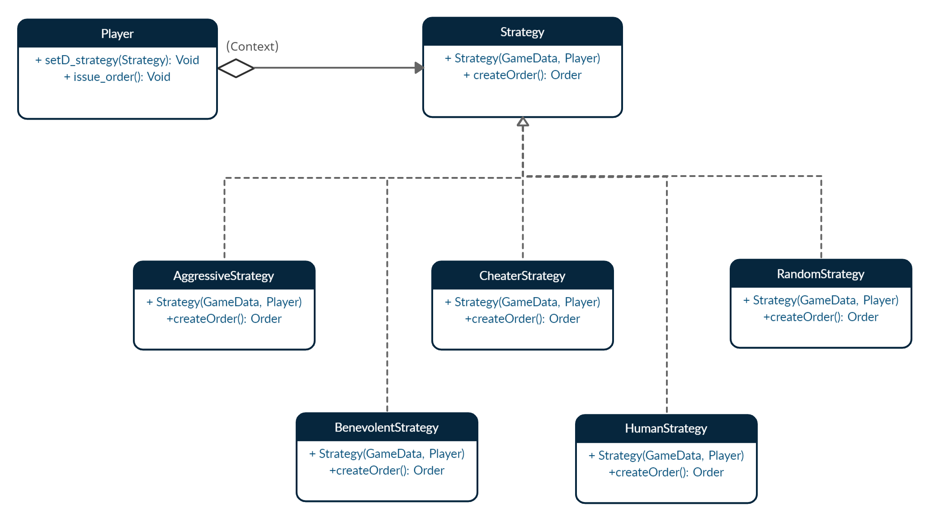
Strategy Pattern Design

Slide 11
MODEL
File | Description
AdvanceOrder.java | This class is used for the advance order command.
AirliftOrder.java | This class is used for the airlift order command.
BlockadeOrder.java | This class is used for the blockade order command.
BombOrder.java | This class is used for the bomb order command.
CommandResponse.java | This class represents structure of response of all the commands.
Continent.java | This class represents continent in the map, and it has a list of countries as well as control value.
Country.java | This class represents country of the map file. It's also having list of neighbor countries.
DeployOrder.java | This class is used for the deploy order command.
GameCard.java | This enum is used for managing the type of card.
GameData.java | This class is used for string and manipulating game play information.

Slide 12
MODEL
File | Description
NegotiateOrder.java | This class is used for the negotiate order command.
Order.java | This is the common interface for all order commands.
OrderTypes.java | This Enum is used for managing different types of orders.
Player.java | This class is used for storing and manipulating player Information.
Strategies.java | This Enum is used for All Types Of strategies.
Tournament.java | This Class is used for Creating Tournament Object.
TournamentWinner.java | This enum is used to inform which strategy player won the Tournament.
WarMap.java | WarMap class is the main model for map management. From here the data structure started. This Map is having Map of continents and continent will have countries and those countries will have their adjacent countries.

Slide 13
VIEW
File | Description
FxmlView.java | This class provides views of Application.
GameConfig.fxml | This file represents View which is responsible for Game Startup phase.
GameEngine.fxml | This file represents View which is responsible for playing game.
Home.fxml | This file represents Main Screen of the game.
MapManager.fxml | This file represents View which represents map related activities.

Slide 14
CONTROLLER
File | Description
GameConfigController.java | This class provides game configuration functionalities such as load map, create player and assign countries to player before the start game phase.
GameEngine.java | This class provides functionalities such as deploy armies, issue orders, and execute orders in round robin fashion.
MapController.java | This class provides map management functionalities such as add an existing map, create a new map.
WelcomeController.java | This class represent main screen of game from which user can navigate to various phases of game.

Slide 15
SERVICES
File | Description
GameConfigService.java | This interface is used for all game related Configuration for game play.
GameEngineService.java | This interface is used to provide function for game playing.
GenerateUtil.java | This interface is used for Utility of General Functions.
MapHandlingInterface.java | This interface is used for Utility of Map Editor related commands.
OrderProcessor.java | This interface is used to process the order based on the user input.

Slide 16
STATE
File | Description
ExecuteOrderPhase.java | This class is used to execute orders which are issued by the players in the previous phase.
GamePlay.java | This abstract class is used is used as a state class in state pattern and defines common behavior to all the states in the group (StartUpPhase, IssueOrderPhase, and ExecuteOrderPhase).
IssueOrderPhase.java | This class is used to take orders from each player in round robin manner.
MapPhase.java | This class is used for map editing command such as create, edit, validate, save, and load map which are valid in this state.
Phase.java | This abstract class is used as a state class in state pattern and defines the behavior that is common to all the states in int group (MapPhase).
StartupPhase.java | This phase is used for startup phase commands such as load map, add and remove players and populate countries between those players.

Slide 17
OBSERVER
File | Description
LogEntryBuffer.java | This is the log entry buffer class used for log application state.
WriteLogFile.java | This class is used to write a message to log file.

Slide 18
ADAPTER
File | Description
ConquestMapReader.java | This Class is used for Reading and Writing Conquest Map File. This is Adaptee class in Adapter Pattern.
DominationMapReader.java | This Class is used for Reading and Writing Domination Map File. This is the Target class in Adapter Pattern.
FileReaderAdapter.java | This Class is used for Adapting ConquestMapReader to Existing map System.

Slide 19
STRATEGY
File | Description
AggressiveStrategy.java | This Class is used for Implementing Aggressive Strategy of a Player.
BenevolentStrategy.java | This Class is used for Implementing Benevolent Strategy of a Player.
CheaterStrategy.java | This Class is used for Implementing Cheater Strategy of a Player.
HumanStrategy.java | This Class is used for Implementing Human Strategy of a Player.
RandomStrategy.java | This Class is used for Implementing Random Strategy of a Player.
Strategy.java | This Abstract class is used as a Basic Structure for various Strategies.

Slide 20
Thank You

